Slide 1
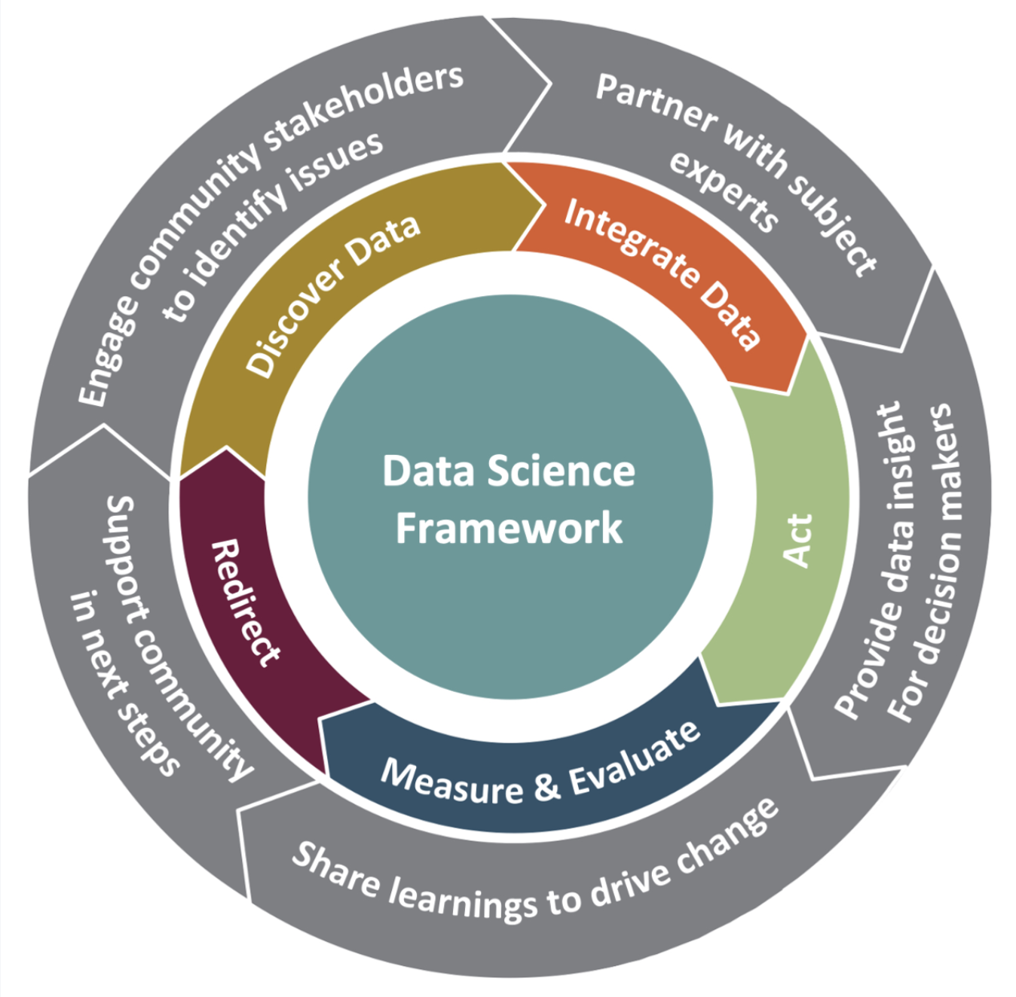





















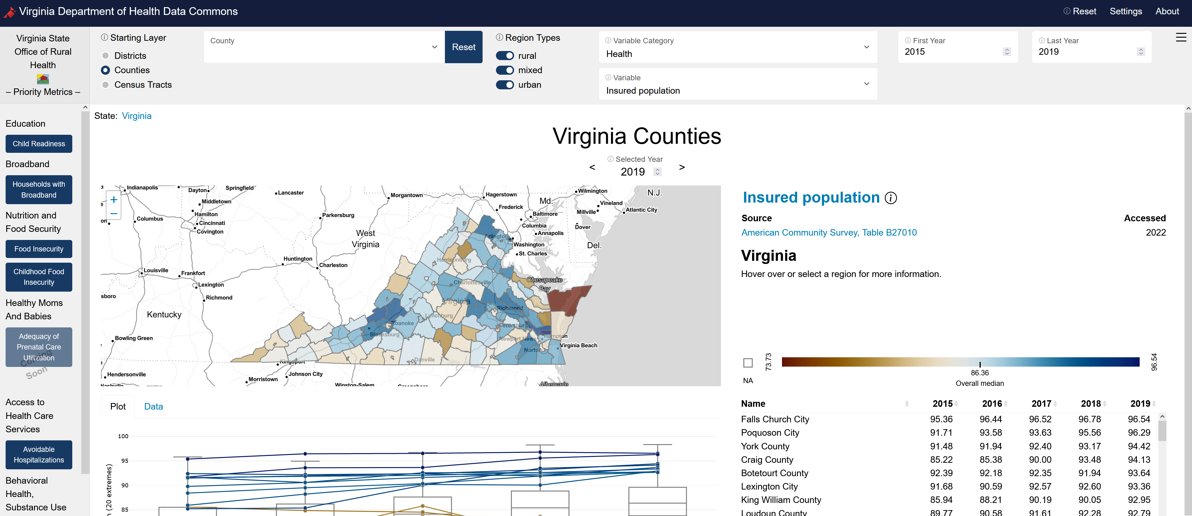

BUILDING A DATA COMMONS
Hanna Charankevich, Micah Iserman, Vicki Lancaster, Kathryn Linehan, Cesar Montalvo, Leonel Siwe, Joanna Schroeder, Aaron Schroeder
WHAT IS A DATA COMMONS?
Open knowledge repository that co-locates data from a variety of sources and curates data insights for governments and community stakeholders.
Provides data, indicators, indices, case studies, and training
Analyzes impact from social, economic, and health trends and major events
Enables ongoing learning from data
Addresses issues of concern, for example, food insecurity, equity, lack of affordable housing
MOTIVATION
To inform equitable and sustainable growth in Virginia and the National Capital Region.
COMMUNITY LEARNING THROUGH
DATA DRIVEN DISCOVERY (CLD3)
The CLD3 framework engages local stakeholders to bring data insights to their most pressing challenges; for example, the Virginia Department of Health Office of Rural Health and Arlington County government.
DATA INTERFACE
KEY FEATURES
Data sources and metadata Collected and created measures Composite metrics Maps reflecting multiple geographies | Data download via web or API Capability to statistically explore the data Sustainable architecture Designed and built in cooperation with localities (CLD3)
DATA COLLECTION
Our team creates novel datasets from linked data that are available at geographical areas over time
Collected data from 20+ sources
Created 50+ derived indicators and indices
Focused on 9 policy areas
Uses a variety of data acquisition and
creation methods:
APIs
Webscraping
Modeling
Spatial linkage
See Demo
HEALTH, BEHAVIOR,
AND DIET
FUTURE STEPS
Refine development of new measures and metrics
Release open-source datasets and tools
Engages stakeholders in the development of metrics
Expand the research to lower geographical coverage
DIGITAL
COMMUNICATIONS
MEDIA COVERAGE
EDUCATION AND TRAINING
UPCOMING PRESENTATIONS
POPULATION CHARACTERISTICS
ECONOMIC WELLBEING
DATA ARCHITECTURE
TRANSPORTATION AND HOUSING
Keller, S. A., Shipp, S. S., Schroeder, A. D., & Korkmaz, G. (2020). Doing Data Science: A Framework and Case Study. Harvard Data Science Review, 2(1).
SOCIAL AND DECISION ANALYTICS
Notes:
Data area teams collect data from a # of sources, apply methods to create our measures for the social data commons
Iterative process with stakeholders
Reconciling and transforming data
Multiple data types/sources

Slide 2
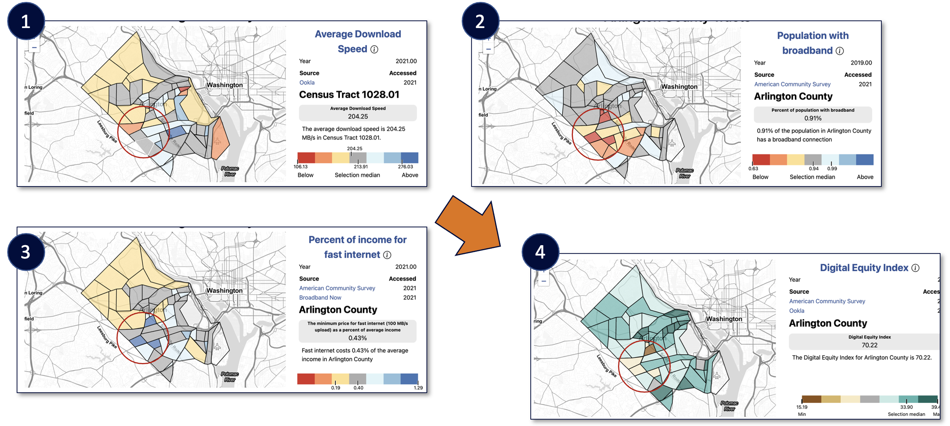
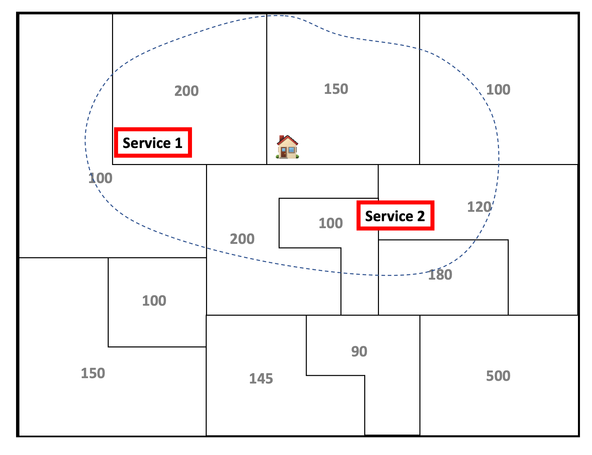
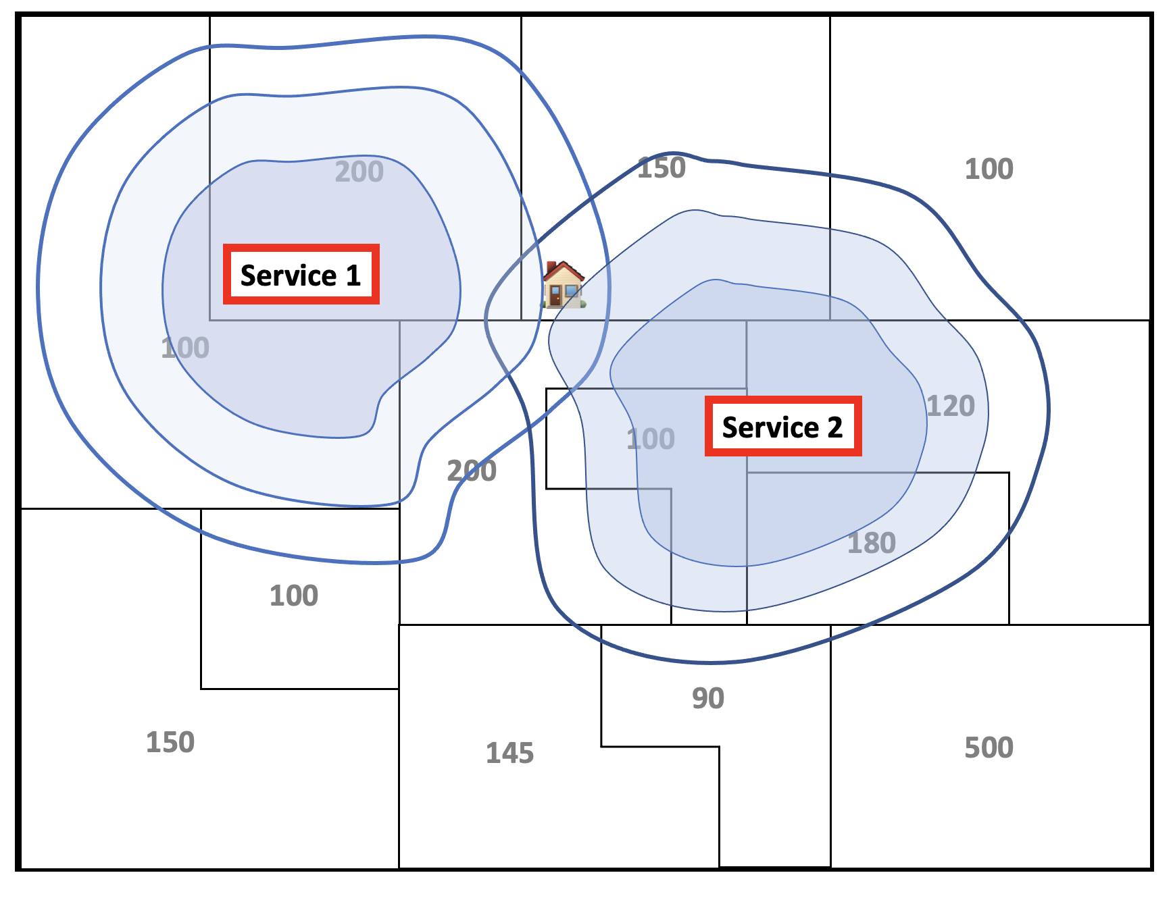
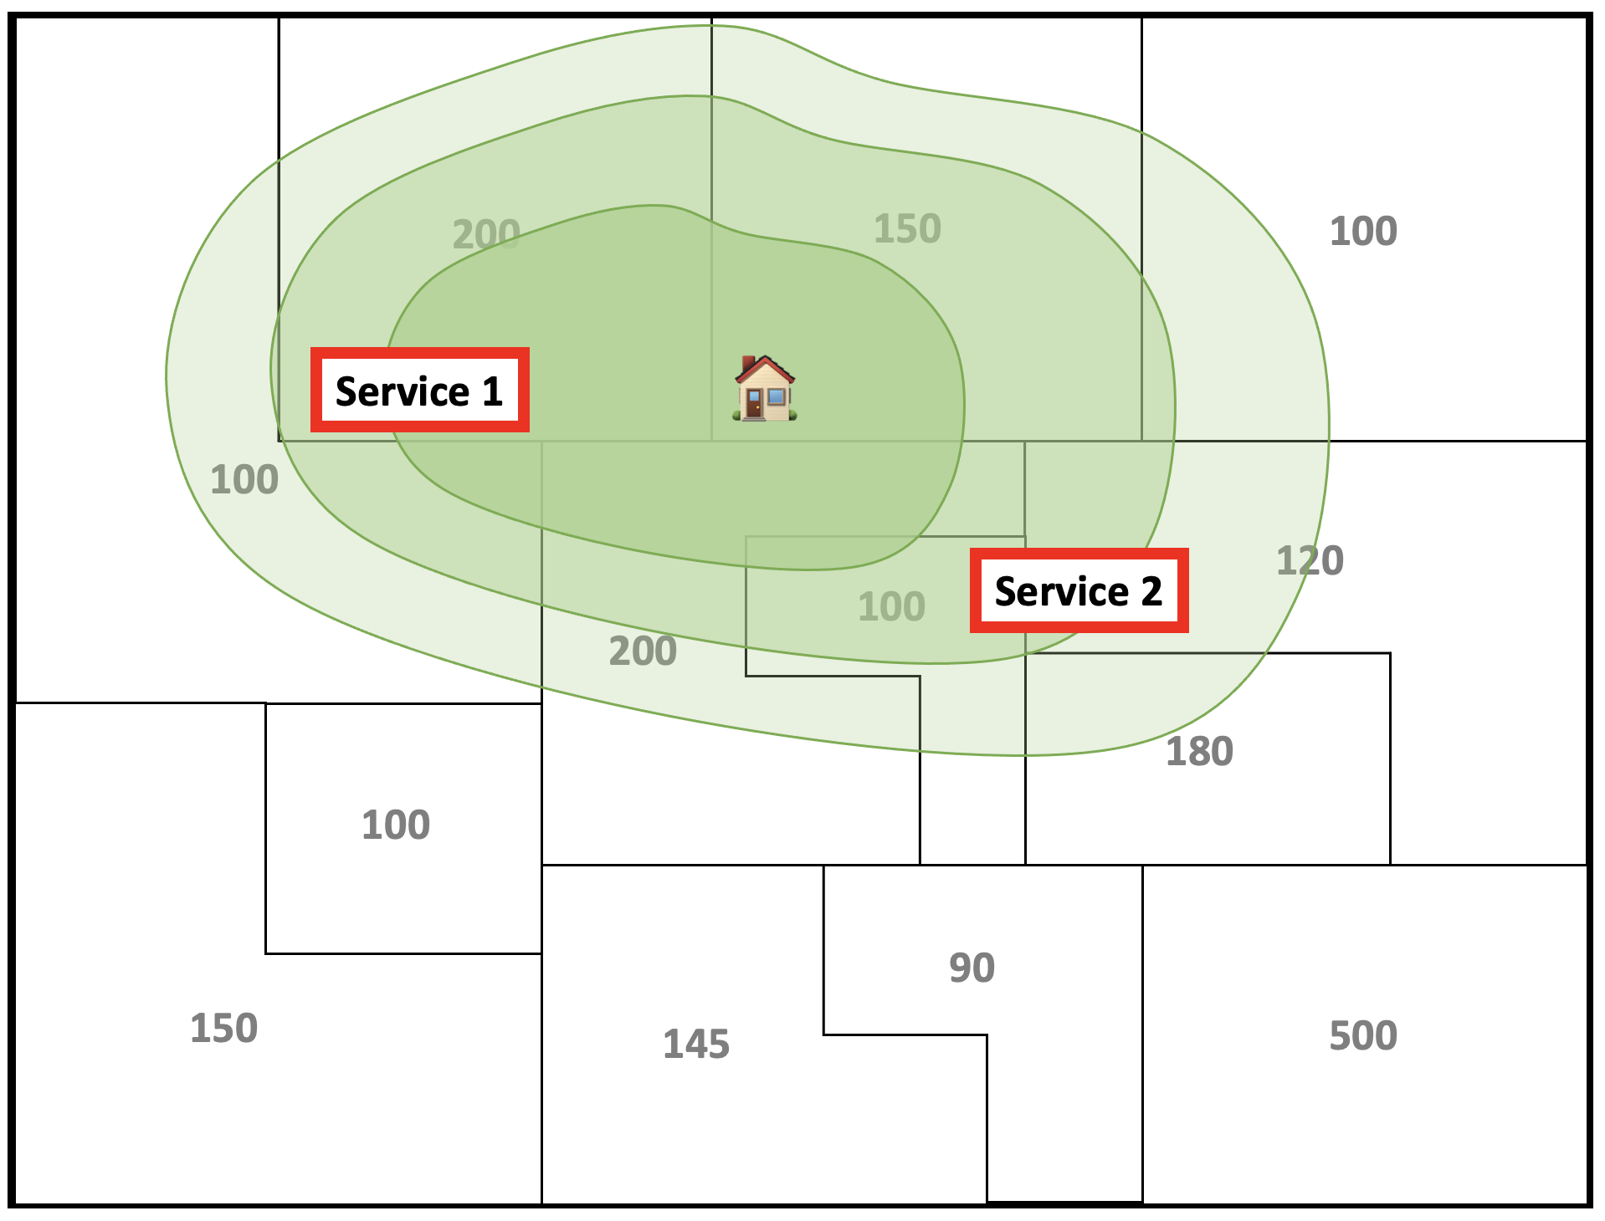
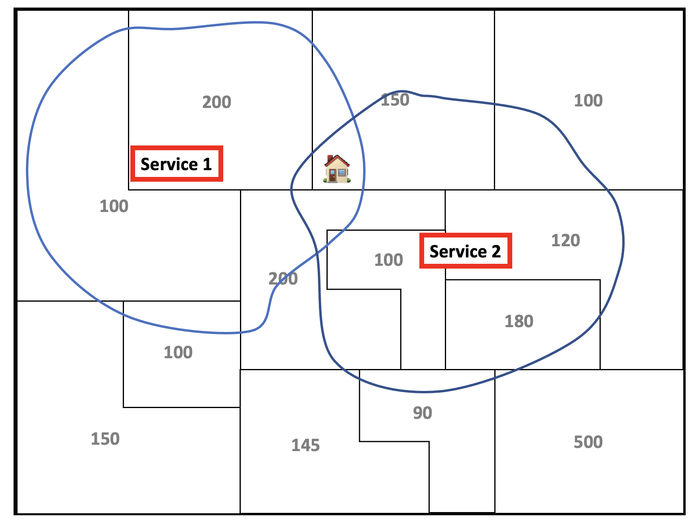
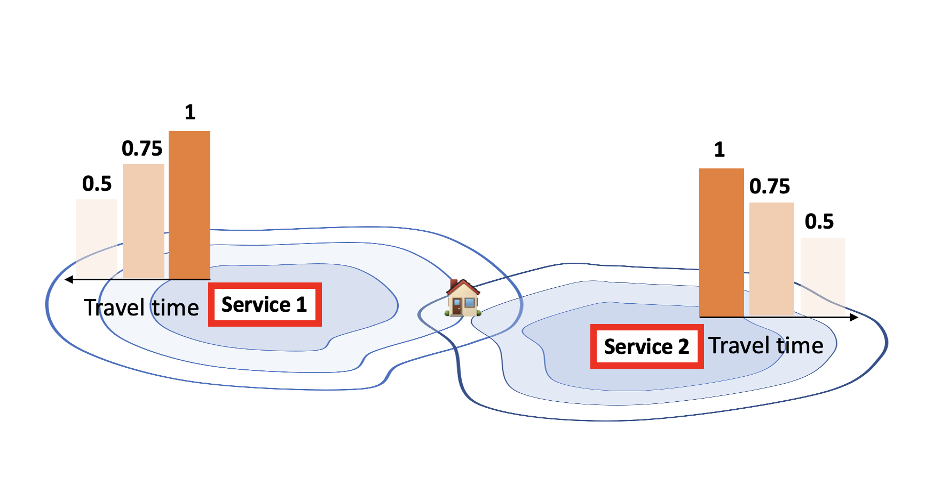
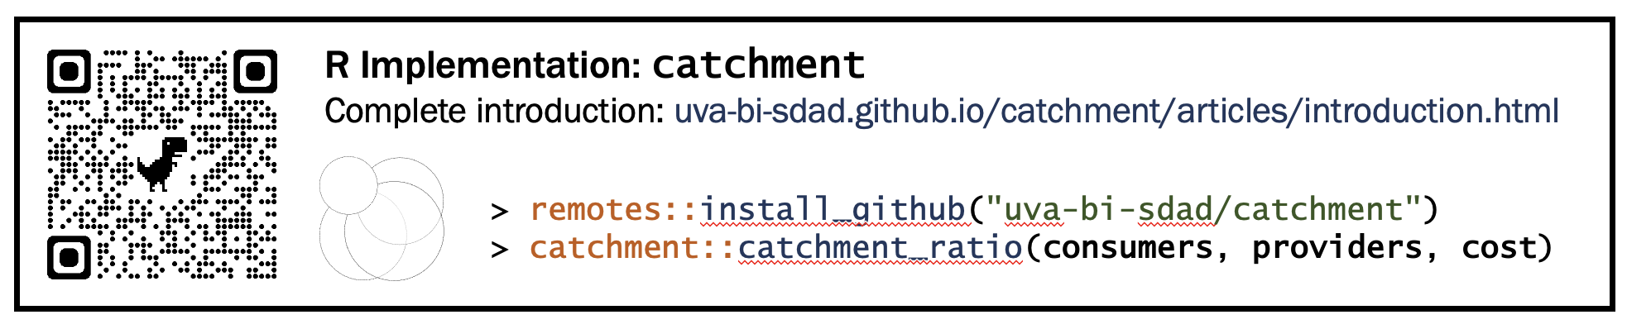
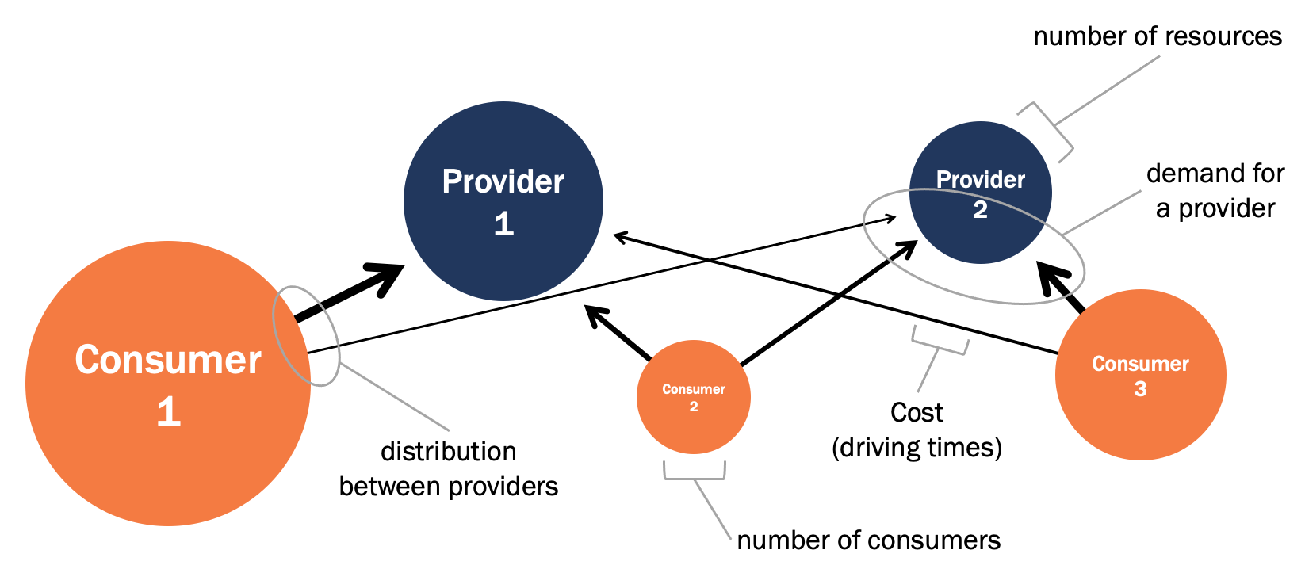
EXAMPLE METRICS
OF THE SOCIAL IMPACT DATA COMMONS
Hanna Charankevich, Micah Iserman, Vicki Lancaster, Kathryn Linehan, Cesar Montalvo, Leonel Siwe, Joanna Schroeder, Aaron Schroeder
Digital Equity Index
A new metric to assess equity of access to broadband​
DEI Four Factor Structure
Digital Accessibility & Education
Percent of Census tract with
at least one computer
internet access
self-reported broadband
over a HS education (ACS; 2019)
Age & Disability Status
Percent of Census tract
under 65
without a disability (ACS; 2019)
Income
Percent of Census tract with income above the poverty level (ACS; 2019)
Ratio between the share of homes making 75,000+ per year with internet and the share of homes making less than 35,000 per year without internet (ACS; 2019)
Percent of total households in Census tract that are not low income (less than 30% of HUD Area Median Family Income) and do not have a housing cost burden over 30% (CHAS; 2020)
Methodology
Use Factor Analysis to identify relationships between nine variables and component factors.
Each factor represents one dimension of the DEI (e.g., Digital accessibility & Education).
Factor scores are calculated by combining associated variables, weighted by their factor loading.
The final DEI score for each area is calculated by combining scores across all four factor, based on Gallardo (2020).
Digital Quality
Census tract average
download speed
upload speed
latency (Ookla; 2019-2021)
Floating Catchment Areas for Specific Services
The floating catchment area (FCA) is a method that identifies spatial accessibility to a specific service, for example, hospitals, supermarkets, schools.
FCA defines the service area by a threshold travel time while accounting for the availability of physicians by their surrounded demands. (Luo et al., 2003)
How many
providers
doctors
grocery stores
are available per
consumer
person
region
?
Three models
Typical Ratio
supply-demand (R)
Two-Stage FCA
Enhanced Two-Stage FCA
Three-Stage FCA
Providers in my area
Proximity of providers
Probability of provider’s selection
R
=
Number of providers
Population
For example:
268.5 physicians per
100 K people in VA
(NCHS, 2021)
205 Police Officers per
100 K people in VA
(BLS, 2021)
Population per area
Providers serve broader area
+
Proximity is weighted by travel time
Probability of selecting a provider given the accessibility of the area
R Package – catchment_ratio
References: American Community Survey ACS (2019). U.S. Census Bureau.
CHAS (2020) Comprehensive Housing Affordability Strategy. U.S. Department of Housing and Urban Development.
Gallardo, R. (2020). Digital Divide Index. Purdue Center for Regional Development. Retrieved from Digital Divide Index (DDI)
Luo, W., & Wang, F. (2003). Measures of spatial accessibility to health care in a GIS environment: Synthesis and a case study in the Chicago region. Environment and Planning B: Planning and Design, 30, 865–884. https://doi.org/10.1068/b29120
National Center for Health Statistics (NCHS) 2021.Number of physicians in patient care per 100,000 resident population, by state: United States, 2018
Ookla (2021) Ookla Speedtest®.
U.S. BUREAU OF LABOR STATISTICS (BLS) 2021. Occupational Employment and Wage Statistics Query System
SOCIAL AND DECISION ANALYTICS DIVISION
Notes:
Data area teams collect data from a # of sources, apply methods to create our measures for the social data commons
Iterative process with stakeholders
Reconciling and transforming data
Multiple data types/sources

